Slide 1

DSA PROJECT
Sentence Completion using Tries
SENTENCE COMPLETION USING TRIES

Slide 2



INTRODUCTION & OBJECTIVES
This project is an sentence completion tool that provides real-time sentence suggestions as users type, powered by a Trie data structure for efficient text retrieval.
Key Objectives:
Effortlessly summarize large text files, saving valuable time.
Enable easy navigation and selection of previously uploaded text files.
Provide quick and accurate sentence suggestions based on user input.

Slide 3

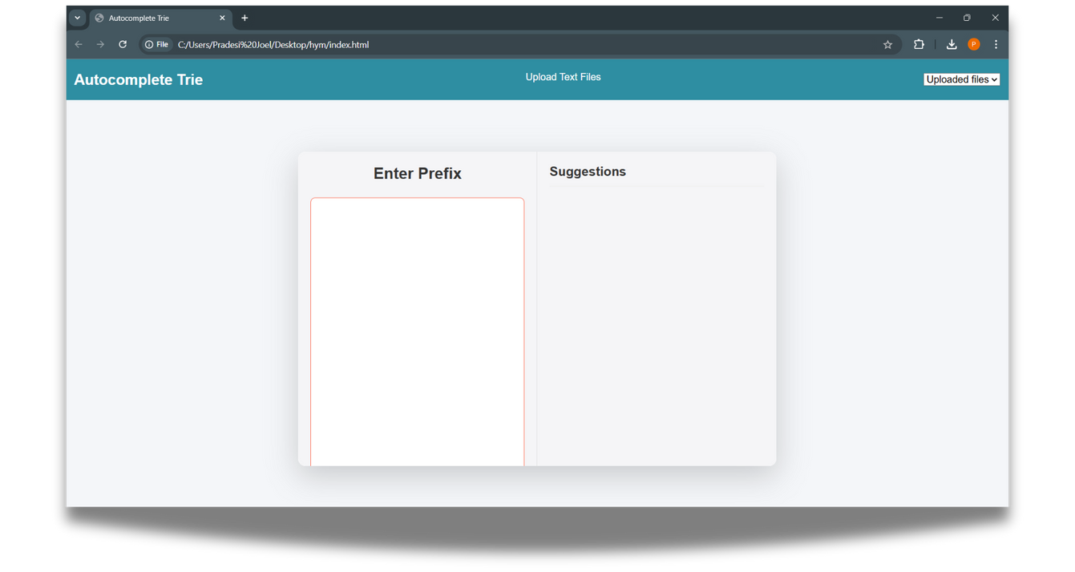
HOW THE WEBPAGE LOOKS
Navbar with File Upload
- Minimalistic design with the project title on the left and file upload button on the right.
- Supports multiple file uploads with a dropdown to select files for autocomplete.
Autocomplete Container*
- Left Column: Large text input box, rounded corners, smooth focus effects.
- Right Column: Shows top five suggestions, with hover effects for easy selection.
Interactive Feedback
- Hover shadows and pointer cursor enhance suggestion interactivity.
- Input and suggestion areas offer clear, responsive feedback for a smooth user experience.

Slide 4

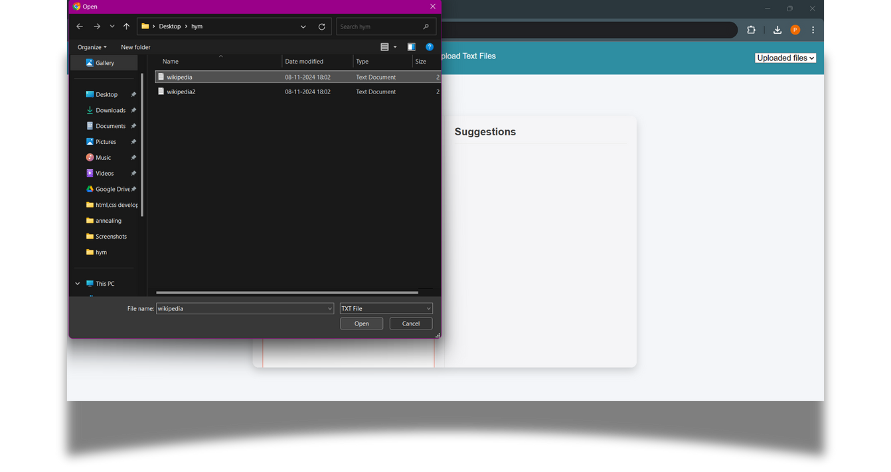
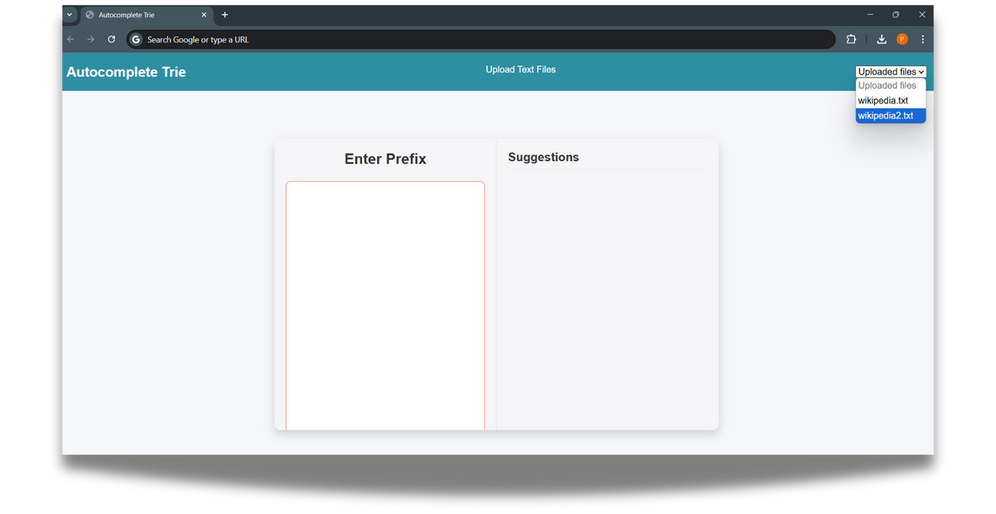
PROJECT FEATURES
File Upload and Management:
Supports uploading multiple .txt files.
Populates a dropdown with file names to enable easy selection.

Slide 5

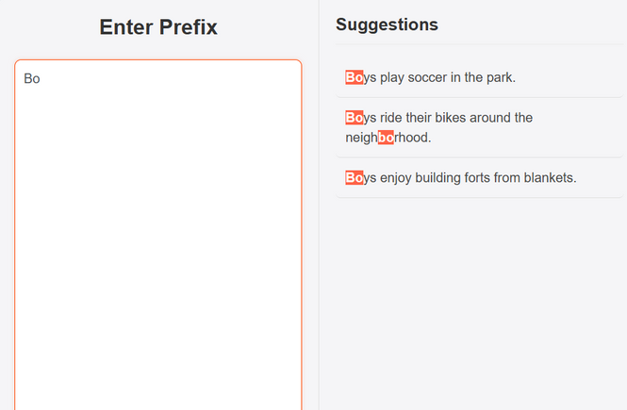
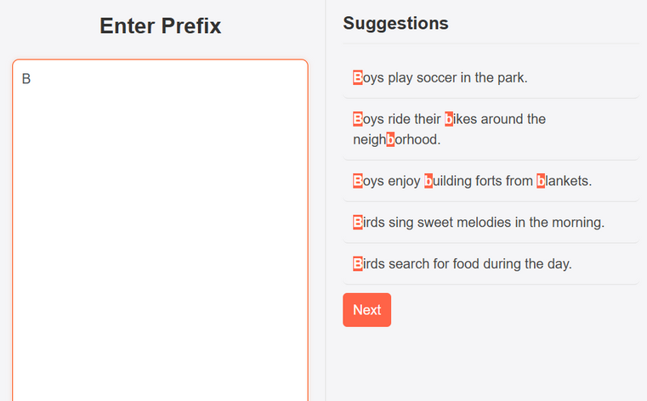

AUTOCOMPLETE FUNCTIONALITY
Description
- As the user types, the system automatically suggests sentences based on the last sentence fragment entered.
- Clicking on a suggestion fills it into the input bar for seamless completion.
Real Time Suggestions
Five Sentence Suggestions
Multiple Sentences
How It Works:
Real-Time Prefix Detection: Detects the prefix after each full stop.
Continuous Autocomplete: Updates suggestions as the user types, providing seamless sentence completion.
Limits the number of suggestions displayed to the user to the top five matches for a clean, focused experience.

Slide 6
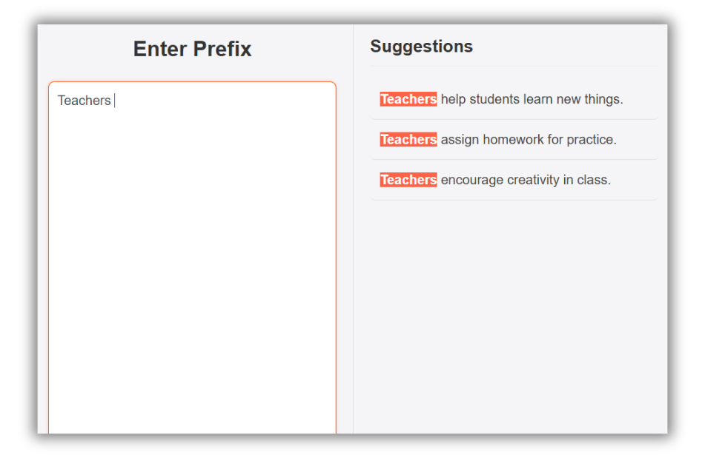
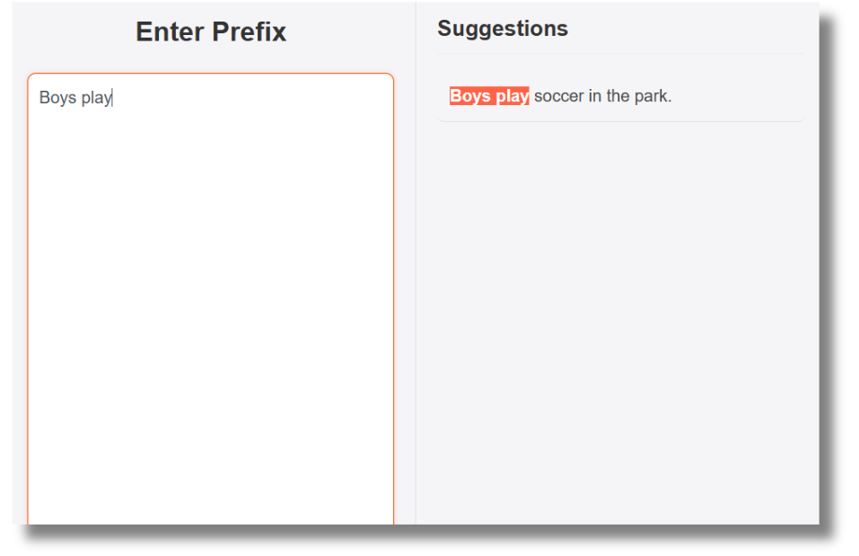
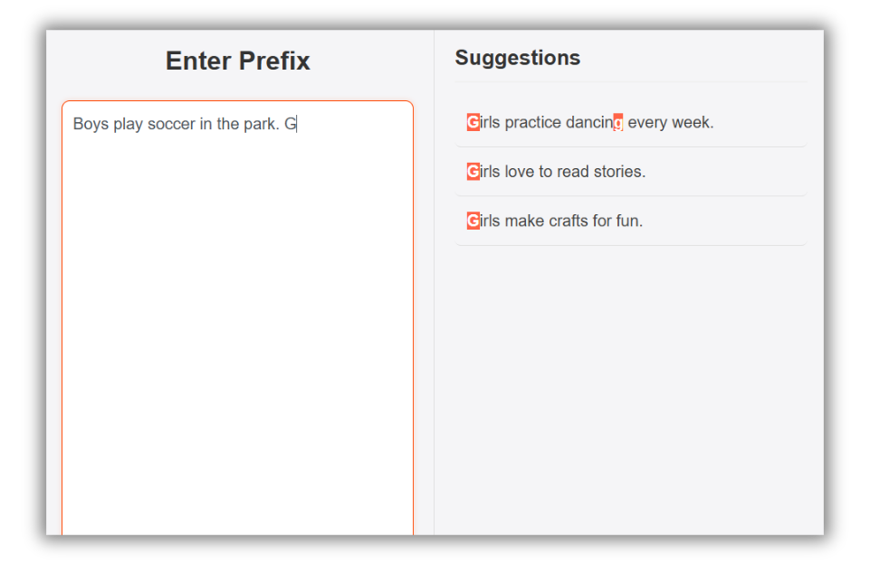

VARIOUS INPUT HANDLING
WORD
PHRASE
Description: Provides continuous suggestions after the user completes each sentence, based on the last typed fragment, even after typing a full stop.
Suggestions After 1 Sentence

Slide 7
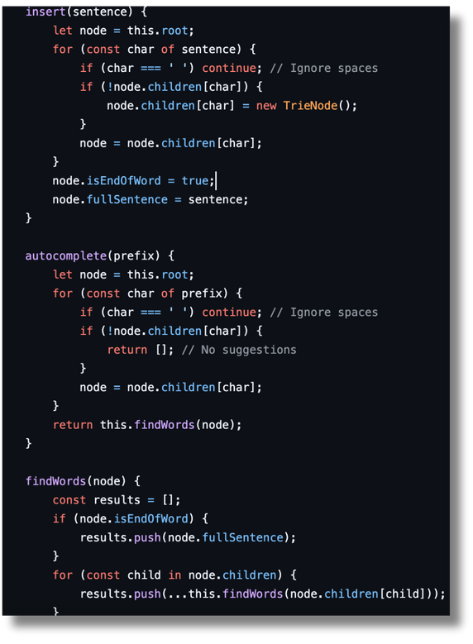
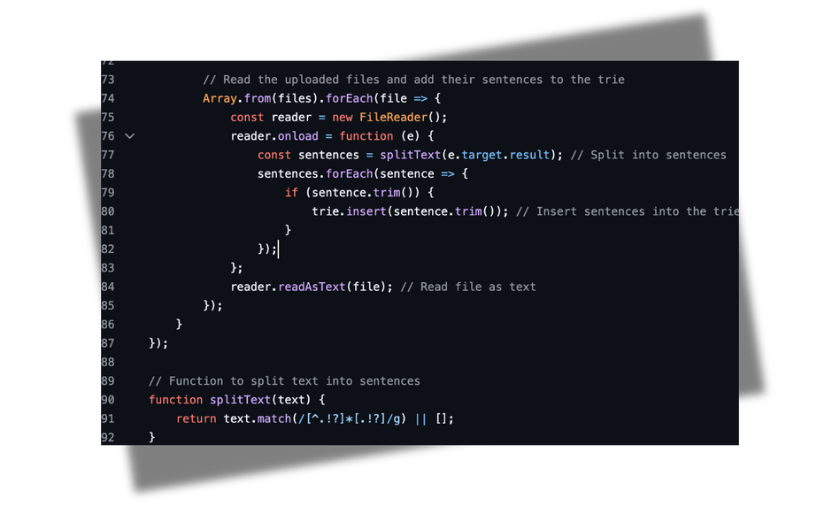



Project Code Overview
Trie Data Structure
Purpose: Efficiently stores and retrieves sentences for autocomplete.
File Handling & Sentence Parsing:
File Input: Enables multi-file upload for sentence suggestions.
Key Methods:
insert(sentence): Adds sentence to Trie, skips spaces.
autocomplete(prefix): Fetches top 5 suggestions for prefix.
findWords(node): Recursively collects sentences from a node.
splitText(text): Splits text by punctuation into sentences.
.

Slide 8
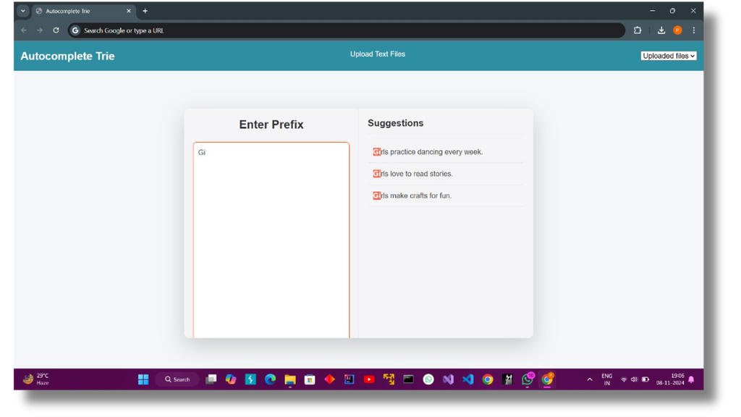
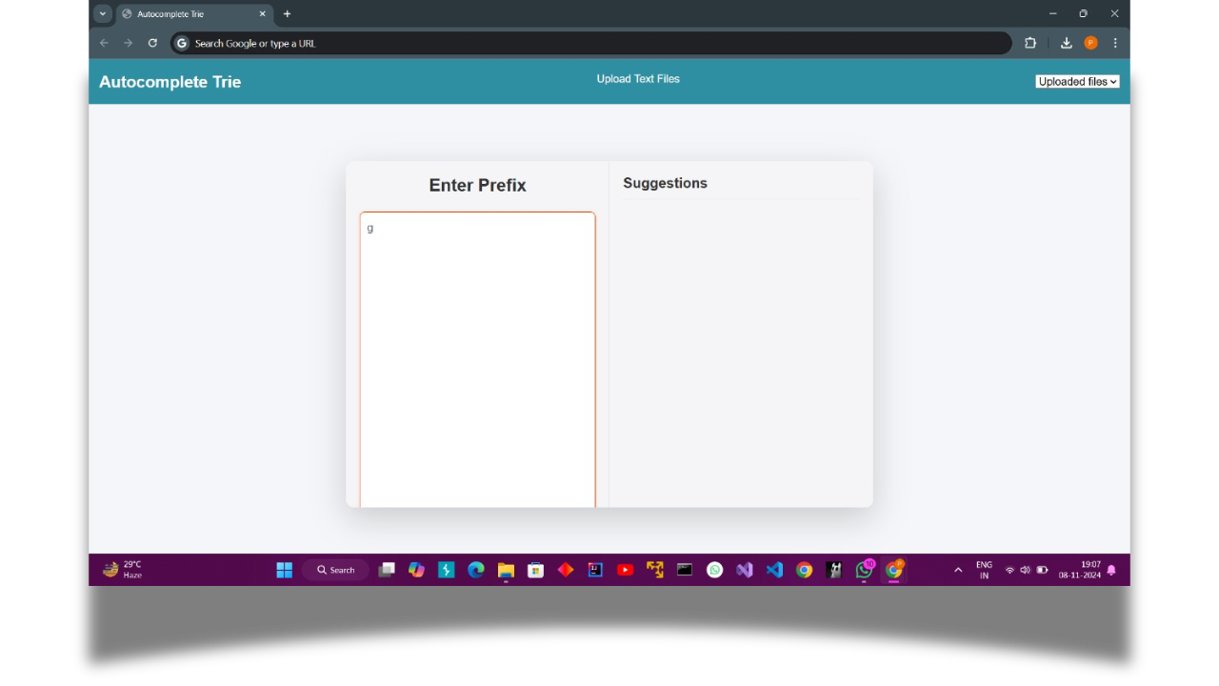
Future Enhancements
Improved Suggestion Algorithm: Weight sentences based on frequency or recency.
Lacks responsiveness & Does not handle URLs
Case-Insensitive Search: Make the Trie search case-insensitive for more flexibility.
Extended File Support: Allow additional text formats, e.g., .docx.

Slide 9
CONTRIBUTORS:
Abhishek Garg (B23EE1081)
Tanisha Sonkar (B23EE1074)
Swarnava Mandal (B23EE1072)

Slide 10
CONTRIBUTIONS:
Initial code and implementation : Abhishek, Tanisha , Swarnava
Multiple files & Seamless search feature : Abhishek
Pagination & Highlight feature : Tanisha
Ui design and ppt: Swarnava
Finalisation of the code : Abhishek, Tanisha, Swarnava

